Slide 1
Industry Skills for Software Engineering Graduates and RSEs
31st August 2026
Ben Thomas, Philippa Wilding, Steve Crouch

Slide 2
Outline
Digital and Professional Skills for Industry Report
How was our training developed & piloted
Discussion - suitable for RSEs?

Slide 3
Keep in mind:
How applicable is our skills training to RSEs?
  Do you work in teams?
  If so, does Agile work for you?
  Are there any other aspects of the training that you would find valuable?

Slide 4
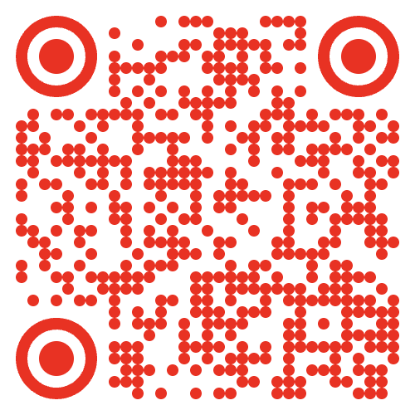
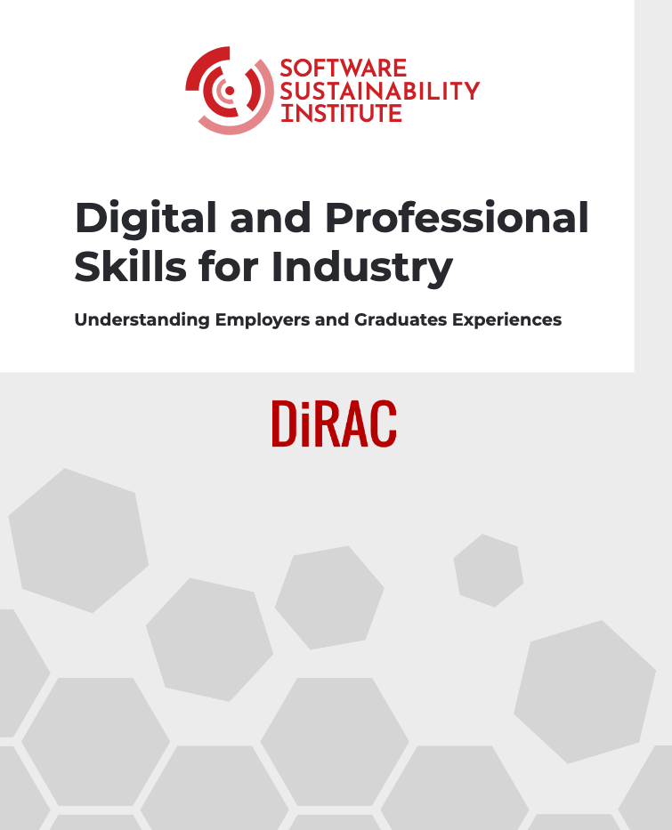
Digital & Professional Skills for Industry Study
We spoke to employers and graduates new to industry
  26 participants
    17 interviews with staff from 11 organisations
      7 multinationals
      2 small and medium enterprises (SMEs)
      2 large UK government organisations
    7 recent graduates and RSEs
    2 key informants with decades of industry experience
We asked about skills needed when transitioning from academia to the workplace, skill gaps, reasons for skill gaps
https://zenodo.org/records/15064213 DOI: https://zenodo.org/records/15064213

Slide 5
Digital & Professional Skills for Industry Study
Technical skills:
  Generally good
    E.g., coding, foundations in STEM
  Practical application of skills not as well supported
    E.g., testing, version control
Professional (soft) skills:
  Learning to code and ability to pick up new knowledge good
  Team work, communication, working with clients not so good
Work experience placements good at developing skills needed for industry - but not enough people have chance to take part
https://zenodo.org/records/15064213 DOI: https://zenodo.org/records/15064213

Slide 6
Why these gaps?
Universities teach in particular ways
  Lecture-style delivery is not practical
  Incentives are individualised, rather than for teams (testing knowledge, grades)
  Time and resource constraints - undergraduate degrees are only 3-4 years

Slide 7
Industry Skills Training
Curriculum based on the outcomes of Industry Report
  Primarily for computer science grads going into software engineering in industry
  Other potential audiences: new recruits to SMEs, PhD students looking to transition to industry
One week bootcamp around agile/Scrum development
Three pilot workshops to test out the materials
  Pilot 1 - first half day, took place in June 2025
  Pilot 2 - first two full days, took place in August 2025
  Full pilot - March 2026

Slide 8
How does the training run?
Training sessions are instructor led, either
  Lecture/exercise based
  Or live coding - where they follow along with the instructor + exercises
Lots of solo / group exercises
  Team-based group project
Business client roleplay: introductory client meeting to establish requirements
Mentoring session with experienced RSE
End presentation

Slide 9
Days 1 & 2 - Foundation
Day 1 - Landscape, Requirements Analysis, & Collaborative Development
Software Development Process and the Landscape of Approaches
User Stories and Capturing Project Requirements
Estimation & Prioritisation
Collaborative Workflow: Branches and Merging Strategies
Pull Requests and Code Reviews
Day 2 - Automation, Agile, & Working with Clients
Introduction to Automated Testing
Writing Unit Tests
Using Continuous Integration
The Agile Development Process
Anatomy of an Agile Sprint
Working with Clients
  Client meeting
  Sprint planning meeting

Slide 10
Days 3 & 4 - Undertaking the Project
Day 3 - First Sprint & Reflection
How to Conduct an Effective Sprint
Sprint 1 Work Block
Sprint Review and Retrospective
Mentoring session with RSE
Day 4 - Releasing Code, Second Sprint & Reflection
Preparing Code for Release
Sprint 2 Planning Meeting
Sprint 2 Work Block
Sprint 2 Review and Retrospective

Slide 11
Day 5 - Delivery to Clients
Teach about preparing to deliver software
Teams prepare presentations to client
Teams present to a panel:
  WHY: Evidence for their choice, e.g. statistics and visualisations
  HOW: How they worked as a team, e.g. process, practices, experiences, challenges & solutions
  WHAT: Final reproducible code in GitHub repository
Feedback, reflections and celebrations

Slide 12

The "Coffee Beans Analysis" Scenario
Based around fictitious local coffee company - "Itchen for a Brew"
Quality of coffee significantly reduced in recent years
  Want to make an evidence-based decision to change suppliers
Company has obtained wealth of coffee supplier data, but lacks skills to analyse
  A previous employee developed rudimentary code - isn't fit for purpose
  Employee has left; no softeng or analytical expertise at the company
Goal - answer question: which country should we send our buyers to?
  Develop code to analyse data to inform the decision
  Focus: the HOW of development, not the WHAT
Image: @nate_dumlao on Unsplash

Slide 13
Feedback
"The course was truly excellent. I'd previously learnt a little about agile development but struggled to retain any of it. This course really helped to put that knowledge into practice. The workshop was well paced, with a good amount of content to feel satisfied without being overloaded."
Feedback from the March pilot was very positive.
Post-training survey indicated an average of 8.5/10 for the effectiveness of the workshop as a learning experience.
In general, comments indicated the experience was a strong, engaging, and practical course with excellent teaching and teamwork elements.
“All practical demonstrations with Git, MkDocs, etc were very engaging and useful - sure to put it to use in the future.”

Slide 14
Next Steps
Plan to develop versions of this training for different audiences
  Graduates at all levels
  Recent recruits to SMEs - as part of the University of Southampton’s offering to the local community
  RSEs

Slide 15
Your questions and comments
General questions?
How suitable is this training for you as RSEs?
  Is this relevant e.g., do you work in teams? Does Agile work for you?
  What aspects of the training would you find valuable?

