Slide 1





An interactive tool to assess the environmental sustainability of novel technologies … and getting recognition for your efforts
Francesco
Barilli
Joana
Morgado
Setenay
Saglam
Didier
Beloin-Saint-Pierre
TSL 506
4 September 2026 – Francesco Barilli

Slide 2
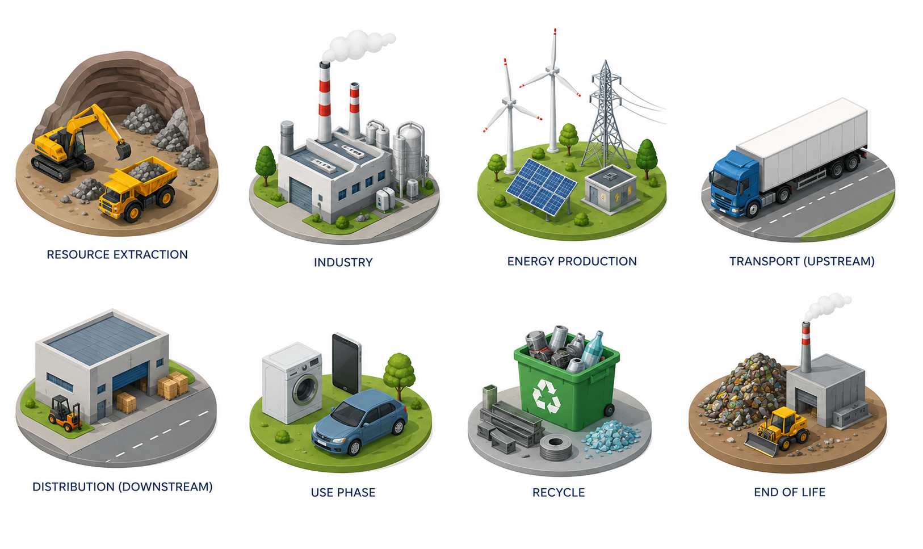
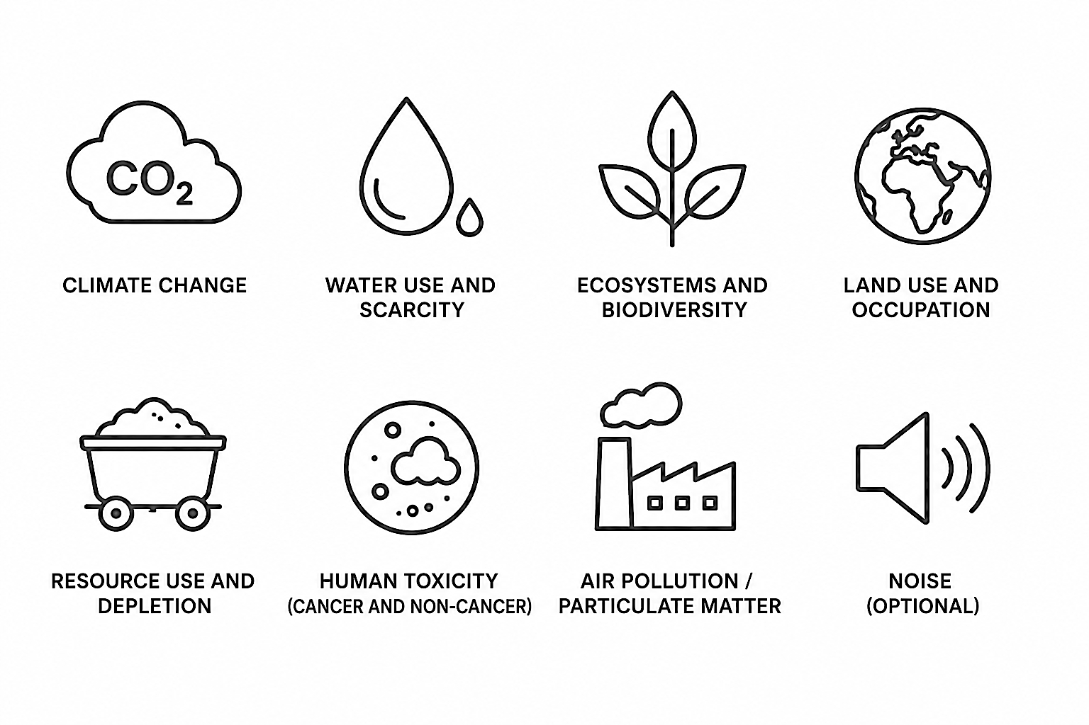
The LCA method can support environmental sustainability assessment
LCA
Industrial production
Distribution (downstream)
Use phase
Resource extraction
Transport (upstream)
End-of-life
Energy production
Recycling
LCA analyses the impacts of the system with multiple environmental dimensions
…
1
Climate change
Water use and scarcity
Ecosystem and biodiversity
Land use and occupation
Resource depletion
Human toxicity

Slide 3
Connecting research expertise with LCA knowledge
Researchers know their processes
Assessing environmental impacts requires additional LCA expertise
CO₂
Materials – Processes – Products – Services – Systems
Transparent Reporting – Modelling Choices – Standard compliance – Iterative
low TRL
Support ecodesign
Provide quantitative evidence of environmental performance
Identify environmental hotspots that should be tackled first
Avoid shifting impacts elsewhere
Our goal:
Make preliminary LCA accessible through transparent and interactive tools that can be easily used with no prior LCA experience
2

Slide 4
LCA requires more than knowing the process
GHG Protocol
…
EN 15804
Product environmental footprint
…
Assessment standard
1 kg of product
ISO 14040/44
PAS 2090
1 device
Climate
Land
LCA
Water
Functional unit
Impact coverage
1 service over one year
Ozone
Mineral resources
Lab-scale vs industrial-scale
cradle-to-gate
A vs B
System boundary
Comparison involved?
…
…
gate-to-gate
cradle-to-grave
Completely new product/service
3

Slide 5
LCA requires more than knowing the process
Assessment standard
Functional unit
Impact coverage
System boundary
Comparison involved
3

Slide 6
Functional unit
System boundary
Impact coverage
…
Assessment standard
Comparison involved
3

Slide 7
LCA requires more than knowing the process
Background system
…
How to properly connect foreground to background?
Raw materials
How to model electricity?
Chemicals
Foreground system
Market based
Electricity
Location based
CO₂
Water
X
Waste treatment
kg CO_{2-eq}
Functional unit
System boundary
Impact coverage
Transparent Traceable Verifiable
Consistent (fair comparison)
LCA reports
…
CO₂
Assessment standard
Comparison involved
4

Slide 8
LCA requires more than knowing the process
Background system
…
How to properly connect foreground to background?
Raw materials
How to model electricity?
Chemicals
Foreground system
Market based
Electricity
Location based
CO₂
Water
X
?
Waste treatment
kg CO_{2-eq}
Functional unit
System boundary
Impact coverage
Transparent Traceable Verifiable
Consistent (fair comparison)
LCA reports
…
CO₂
Assessment standard
Comparison involved
4

Slide 9
LCA requires more than knowing the process
Background system
…
How to properly connect foreground to background?
Raw materials
How to model electricity?
Chemicals
Foreground system
Market based
Electricity
Location based
CO₂
Water
X
?
Waste treatment
kg CO_{2-eq}
Tool #1: web-based adaptive questionnaire
Functional unit
System boundary
Impact coverage
Transparent Traceable Verifiable
Consistent (fair comparison)
LCA reports
…
CO₂
Assessment standard?
Comparison involved?
4

Slide 10


Slide 11
LCA requires more than knowing the process
Background system
…
How to properly connect foreground to background?
Raw materials
How to model electricity?
Chemicals
Foreground system
Market based
Electricity
Location based
CO₂
Water
X
?
Waste treatment
kg CO_{2-eq}
Functional unit
System boundary
Impact coverage
Transparent Traceable Verifiable
Consistent (fair comparison)
LCA reports
…
CO₂
Assessment standard
Comparison involved
4

Slide 12
LCA requires more than knowing the process
Background system
…
How to properly connect foreground to background?
Raw materials
How to model electricity?
Chemicals
Foreground system
Market based
Electricity
Location based
CO₂
Water
X
?
Waste treatment
kg CO_{2-eq}
Functional unit
System boundary
Impact coverage
Transparent Traceable Verifiable
Consistent (fair comparison)
LCA reports
…
CO₂
Assessment standard?
Comparison involved?
4

Slide 13
LCA requires more than knowing the process
Background system
…
How to properly connect foreground to background?
Raw materials
How to model electricity?
Chemicals
Foreground system
Market based
Electricity
Location based
CO₂
Water
X
?
Waste treatment
kg CO_{2-eq}
Functional unit
System boundary
Impact coverage
Transparent Traceable Verifiable
Consistent (fair comparison)
LCA reports
…
CO₂
Assessment standard?
Comparison involved?
4

Slide 14
LCA requires more than knowing the process
Background system
Tool #2: web-based inventory tool
…
How to properly connect foreground to background?
Raw materials
How to model electricity?
Chemicals
Foreground system
Market based
Electricity
Location based
CO₂
Water
X
?
Waste treatment
kg CO_{2-eq}
Functional unit
System boundary
Impact coverage
Transparent Traceable Verifiable
Consistent (fair comparison)
LCA reports
…
CO₂
Assessment standard?
Comparison involved?
4

Slide 15



Slide 16


From LCA expertise to interactive research tools
Web-based adaptive questionnaire
Web-based inventory tool
Consistent
guidance on modelling & reporting
Simple & flexible
structured system modelling
Transparent guidance for LCA result reporting
Researcher-controlled & machine-readable outputs
Help us improve the tools
What works? What is missing?
Scan the QR codes
Excel prototype
AI-assisted development
Testable websites
User testing
5

