Slide 1

Research Software Engineering in the Age of Generative AI
Michelle Barker, Director, Research Software Alliance
With Stephan Druskat, Richard Littauer, Sandra Gesing
Delivering Quality and Efficiency for the Automotive Industry
Based on slides by Stephan Druskat (https://doi.org/10.5281/zenodo.21969773) and Richard Littauer (for RSAA26)
SLIDES: tinyurl.com/swiss-barker
michelle@researchsoft.org
www.researchsoft.org

Slide 2
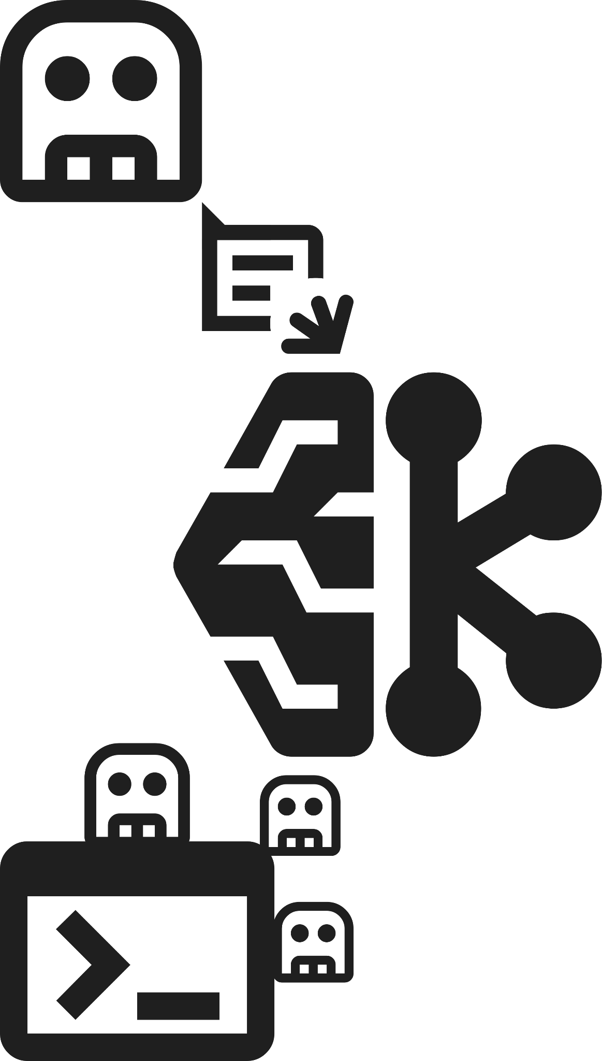

AI is changing the way research software is created
🧑‍🔬
+
=
Researcher
LLM Chatbot / Coding Agent
Prototype
Notes:
In the domain of research software, generative and agentic AI
Do lower the barrier to entry for producing code and other software artifacts
Do reduce the time it takes to produce code.
In practice, this means that researchers who have not programmed before can now create research software by using just natural language.
Potentially, the quality of code that researchers produce may also improve, depending on the experience and focus of the researchers

Slide 3

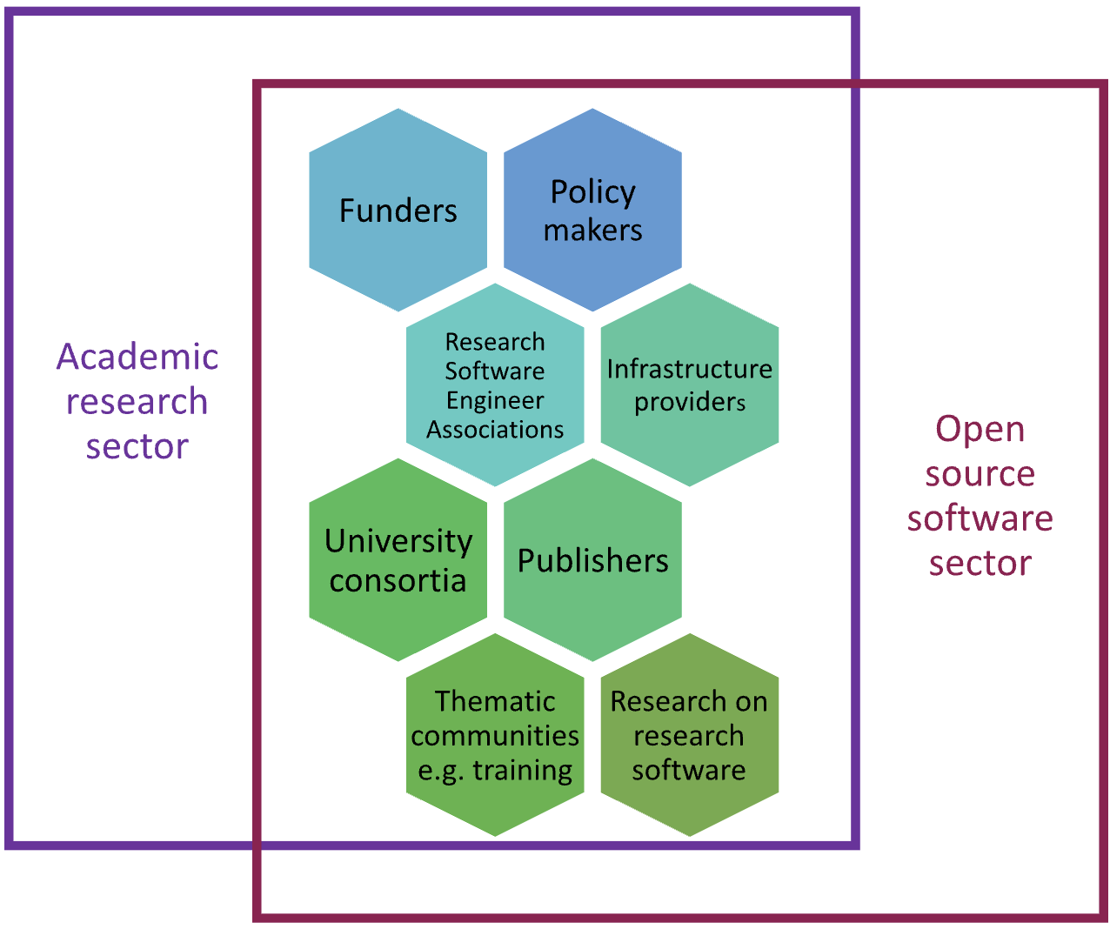
Research Software Alliance (ReSA)
Vision:
Research software and those who develop and maintain it are recognised and valued as fundamental and vital to research worldwide.
Mission:
To advance the research software ecosystem by collaborating with decision makers and key influencers.

Slide 4

Research software is critical to the future of AI-driven research
AI is dependent on software - data preparation and model training are performed by software, models are implemented in software.
With Digital Research Alliance of Canada

Slide 5
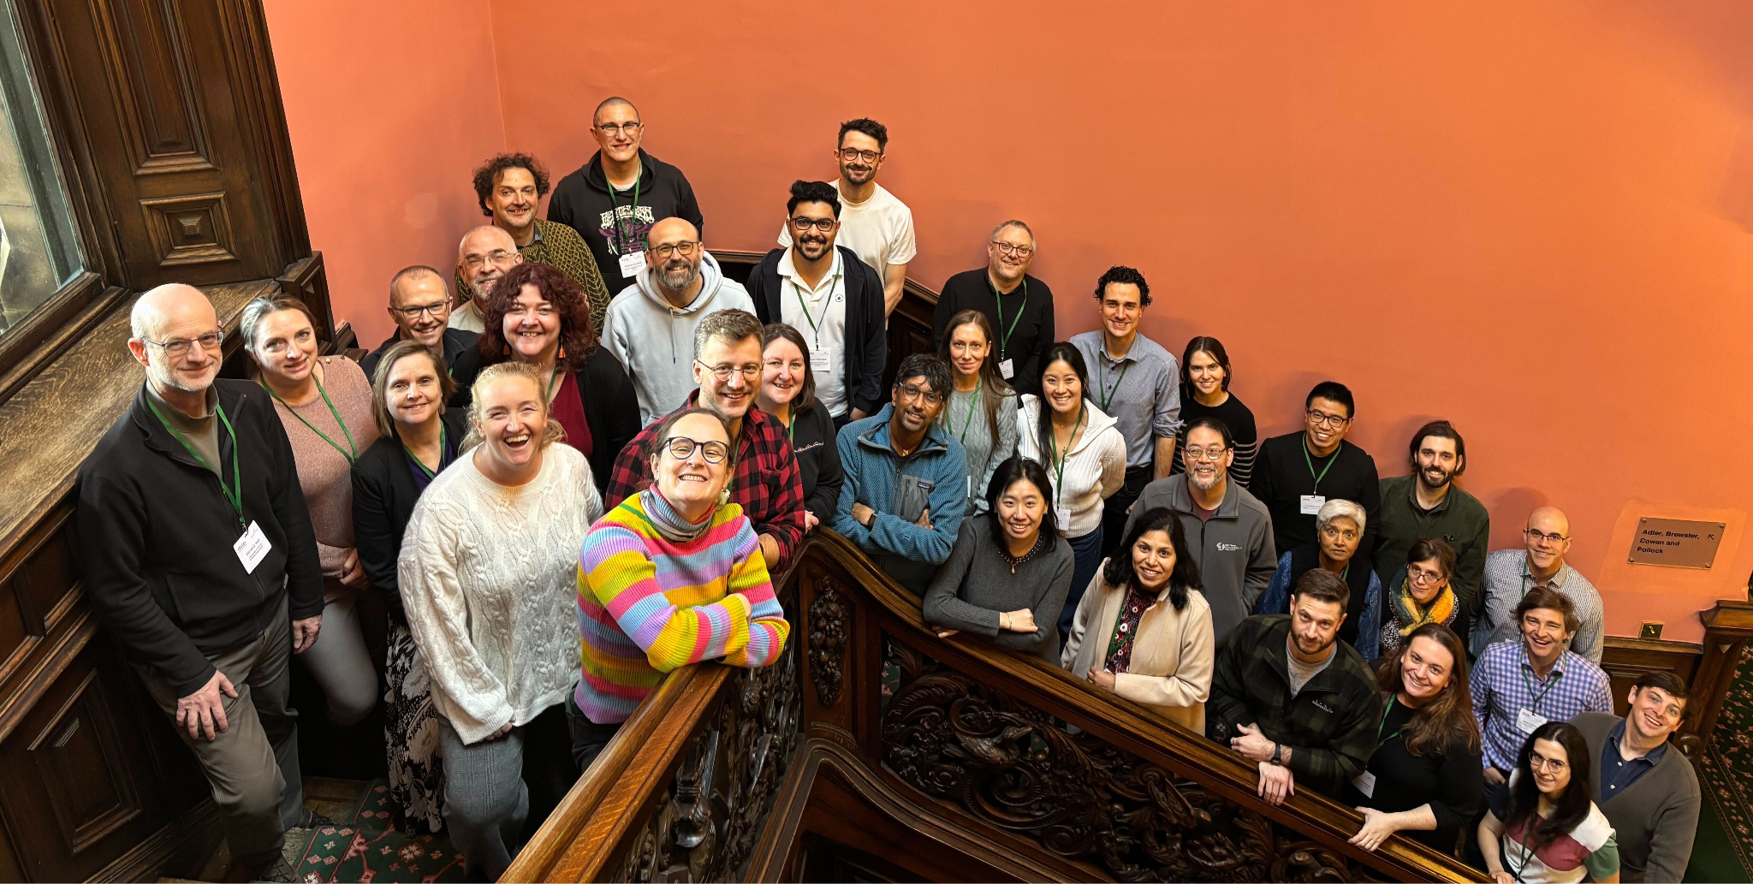
Edinburgh workshop - March 2026
Co-led with Schmidt Sciences
Two major outputs:
Research Software Engineering in the Age of Generative AI: Building a Community Vision report
Research Software in an Age of AI-Assisted Development: Reflections from Edinburgh
Image credit: Stephan Druskat

Slide 6
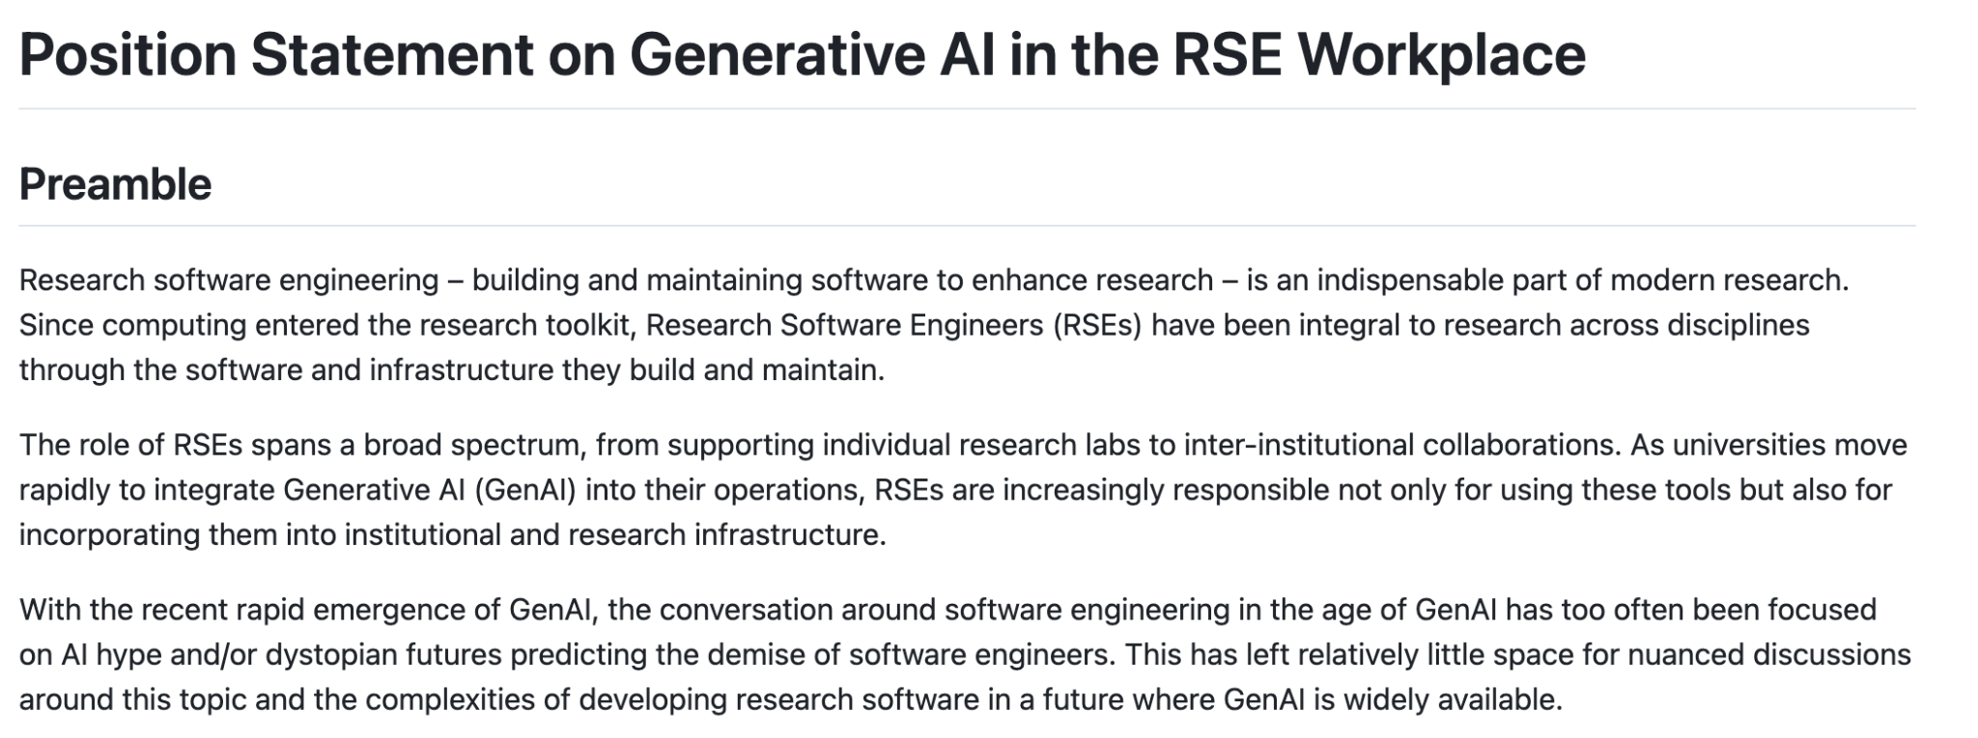
This built on the ADSA and US-RSE Position Statement on Generative AI in the RSE Workplace, which includes:
Research software engineering work is people work
GenAI is a tool, not a substitute for human judgment
Sustainability and transparency matter more than ever
Join the list of signatories

Slide 7
Principles
The ultimate measure of the value of research software is the knowledge and progress it enables.
The pursuit of knowledge is a human responsibility
Engineering discipline is more important than ever
Transparency and reproducibility remain mission-critical
Software engineering is a function, not just a role
Sustainability requires investment in people

Slide 8
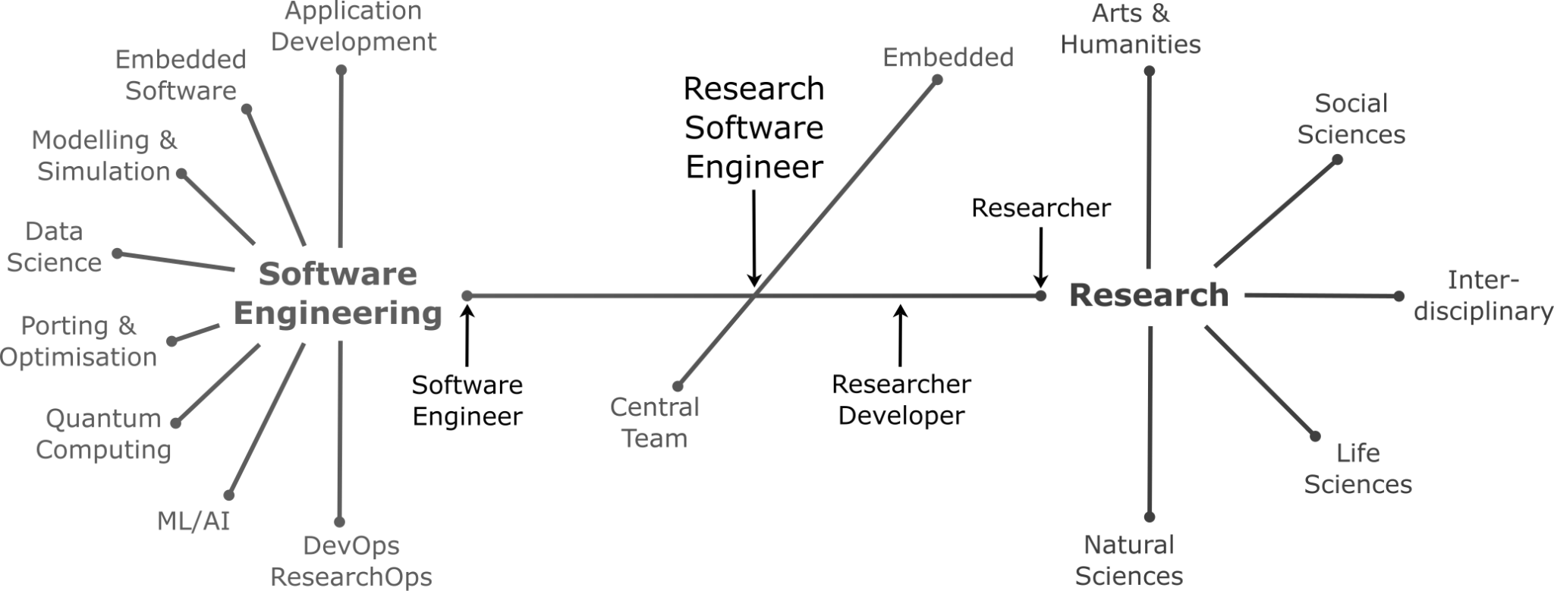
The original value of RSEs
Bridging the worlds of research and software engineering
Notes:
Starting at the beginning
Significant majority of research results rely on the quality of research software
RSEs emerged as a result, and wherever we are on the dimensional spectra:
Professional software engineering expertise + understanding of the research
Partnerships with researchers, software evolves with research
Guide application of methods and technologies, in the software + in the development processes
Safeguard reliability + reproducibility standards for research software
RSEs cover a spectrum of expertise, experience and interest between software engineering and research
The unique value of all RSEs, irrespective of their individual focus, is that they have both software engineering and research expertise

Slide 9
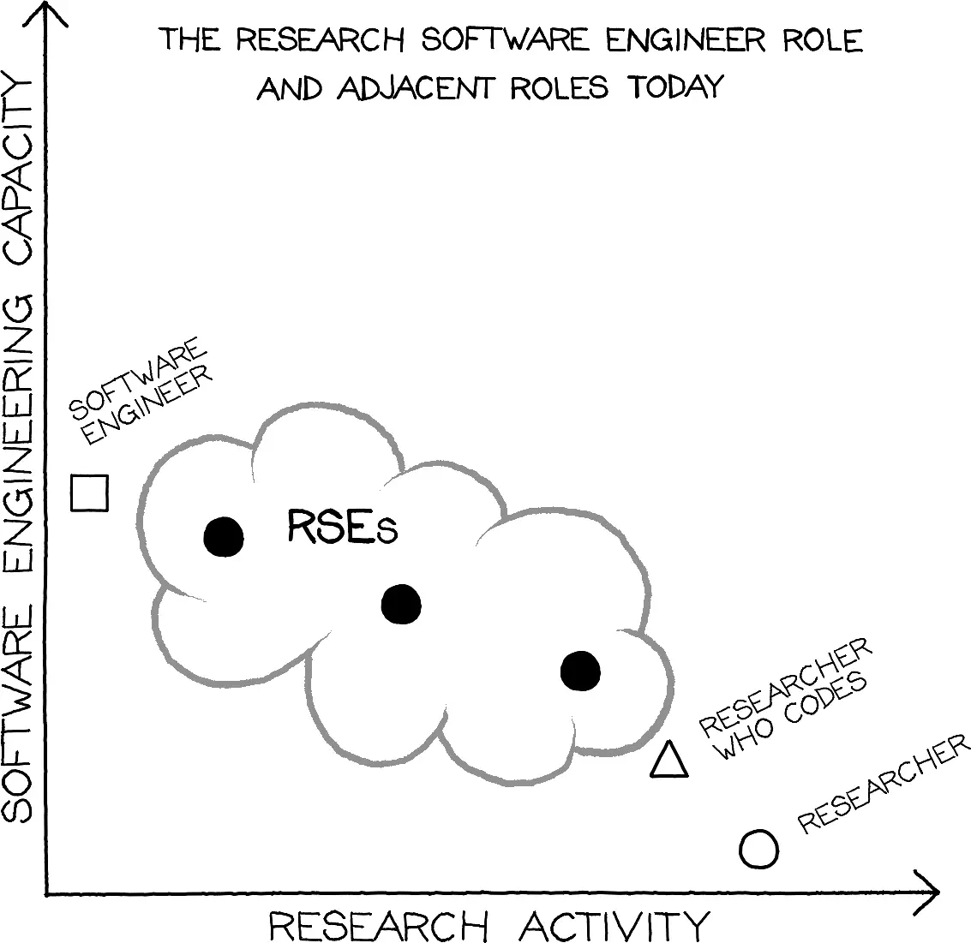
Blog post by ReSA community members:
Research Software Engineers in the Age of GenAI: Same Value, Changing Practice
Image credit: Stephan Druskat

Slide 10
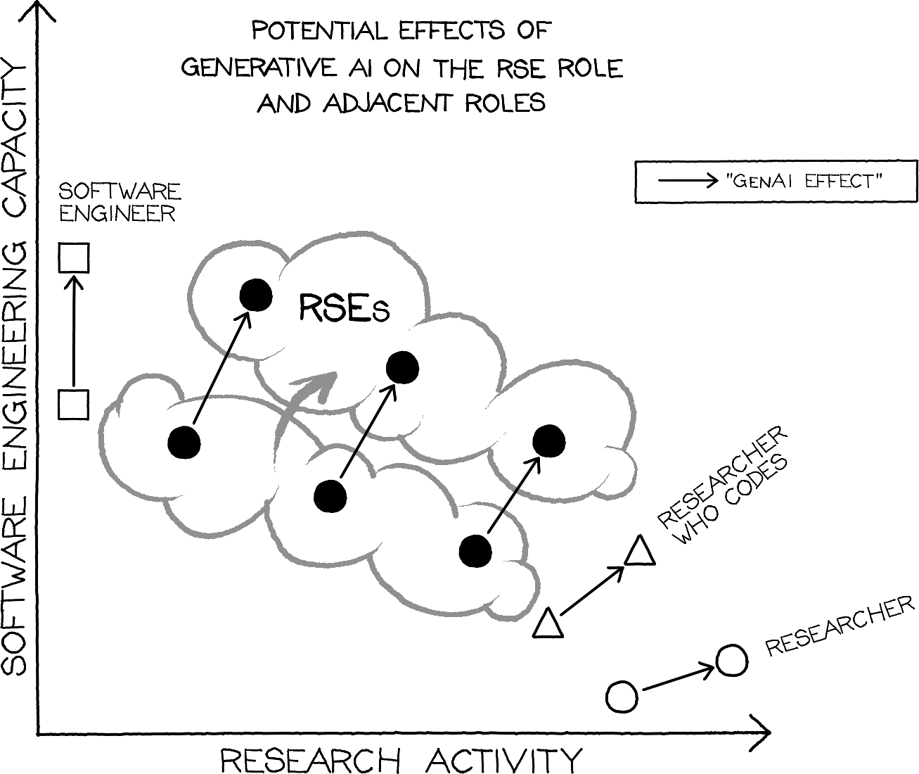
  RSE experience helps us deal with the new challenges and increased insecurities around software quality that GenAI brings
  RSE experience helps sustainably leverage AI for the productivity gains that it promises, while maintaining critical and responsible use
Notes:
The value of the RSE role increases under the effects of GenAI, as:
RSEs’ experience help us deal with the new challenges and increased insecurities around software quality that GenAI brings
RSEs’ experience help sustainably leverage AI for the productivity gains that it promises, while maintaining critical and responsible use

Slide 11
AI is changing the practice of RSEs
Verifying AI-generated software
↑
Designing software
↑
Writing code
Quality / Dependability / Security / Sustainability Engineering
↑
Software Engineering
↑
Programming
Notes:
Engineering software with the help of AI tools means shifting the focus of our work to higher levels of abstraction:
Less time is spent on writing source code
More time is spent designing software and specifying systems in natural language
There is more focus on the verification of AI-generated artifacts
In a way, the job of a software engineer has not changed at all, the focus is actually shifting back to the engineering
Writing code has always been a bottleneck
Software engineering research has always developed systems for code generation (auto-completion, code recommendation)
One of the main differences between past solutions for artifact generation and using AI is the mode:
Natural language instead of formal languages or models
This lowers the barrier to entry for producing code and other software artifacts, and the time it takes to produce these artifacts.
In general, especially LLMs’ natural language interfaces seem to make software or code production easier
At the same time, they re-introduce the syntactic and semantic imprecisions that natural language inherently has
(Especially, when it is used in ways that minimize language input to optimize use of tokens, and the money that may have been spent on them)
AI use also reinforces focuses on specifying the software, and on evaluation and validation, as the user ultimately deals with a probabilistic artifact generator

Slide 12
AI will not change the value of RSEs
Previous SE experience is crucial for productivity gains & sustained quality
Less experienced developers
Significant short term productivity gains [11-13]
No skills improvement, dependency on AI tools [11]
Without AI, productivity drops and does not recover [11]
Experienced developers
Smaller, stable and sustained productivity gains [13,16]
Critical and selective AI use [15]
More distrust of AI-generated results [14]
See also [17,18]
Notes:
… because AI does not benefit everyone’s work the same
The difference, according to recent studies, is previous SE expertise

Slide 13
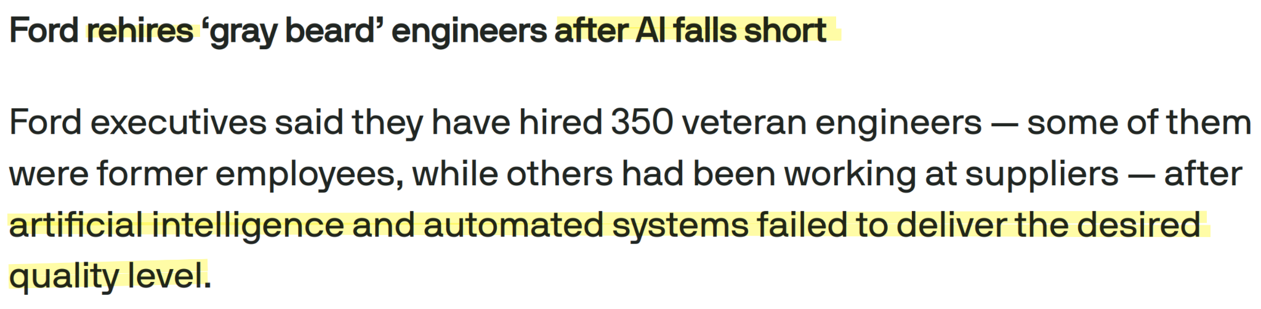
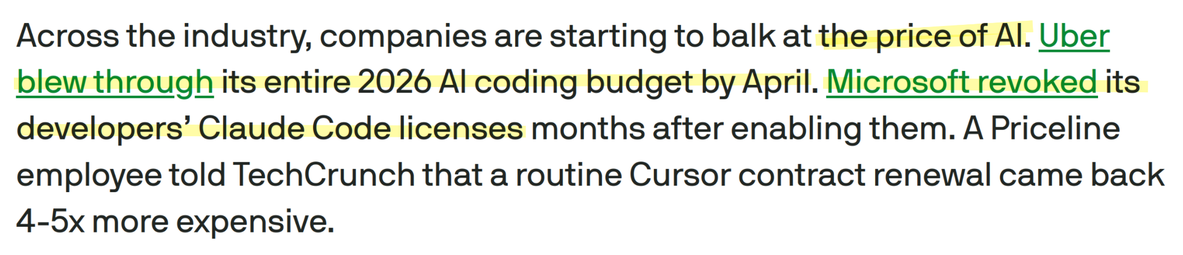
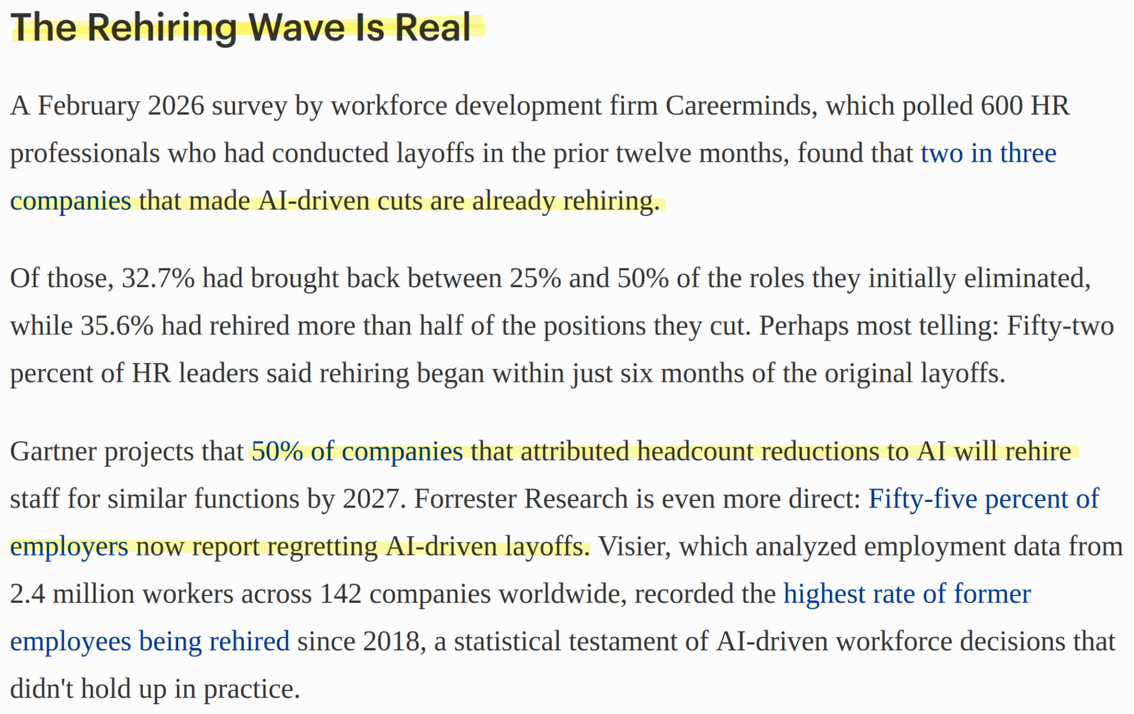
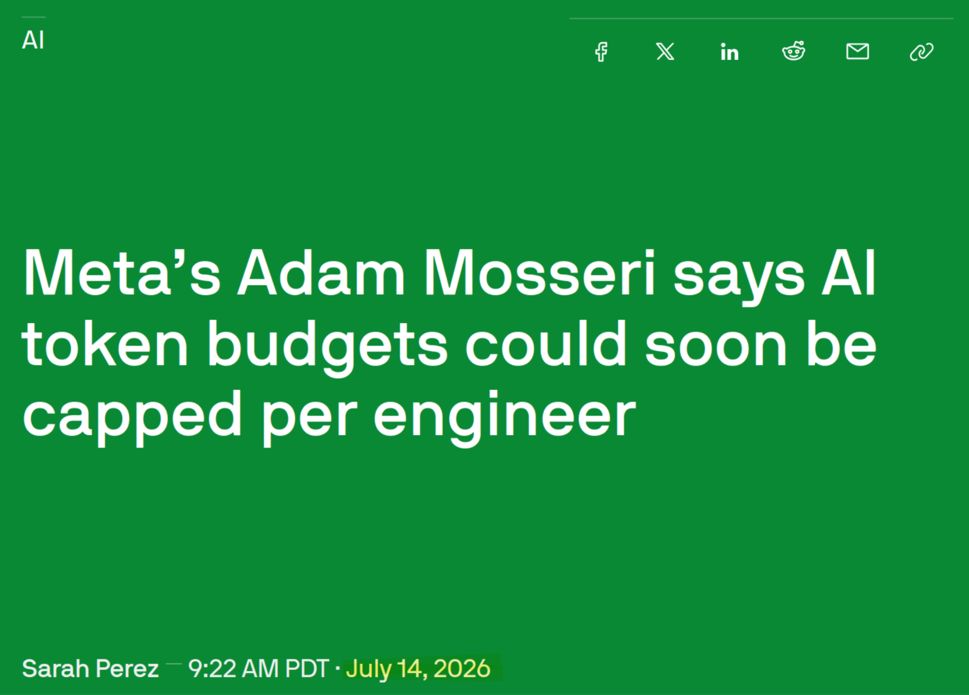
AI is not making software engineers redundant
Sources: [7-10]

Slide 14
9 themes
Research Software Engineering in the Age of Generative AI: Building a Community Vision:
Suggesting policies and narratives for research-performing institutions
Developing a framework to discover, document and address costs, benefits, and risks
Understanding future incentives around publishing, preserving and crediting software
Verifying and validating research software
Defining pathways for the evolution of the research software engineers (RSE) role
Identifying and developing necessary training
Developing a playbook for RSE managers and open-source software project leaders
Making GenAI accessible to all
Collaborating together across people, community, and disciplines, not just with AI

Slide 15
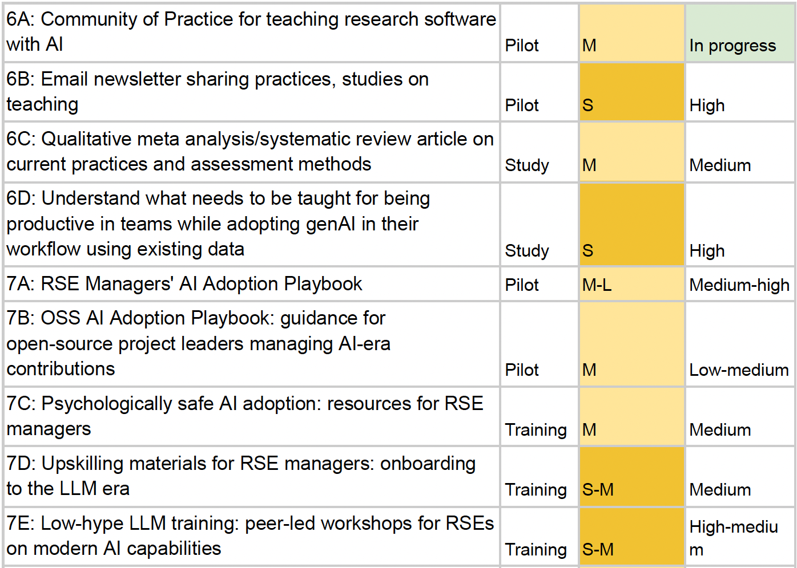
AI Carpentry Teaching Discussion

Slide 16
9 themes - What are you working on?
If you or your organisation has an initiative related to one or more of these themes (whether already underway, in development, or at an early stage), please share it through this short form by 16 Sept.
Indicate the relevant theme(s), identify a specific pilot project where applicable, and choose whether the information you provide can be shared publicly.
Survey goals:
Share publicly who is working on what, possible connections, gaps
For use in upcoming series of ReSA webinars

Slide 17
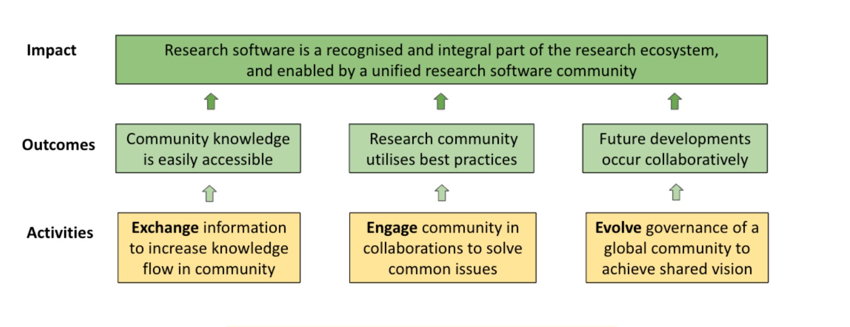
How ReSA Works
Markets
Markets
Markets
Markets

Slide 18
ReSA Forums
ReSA convenes forums for research software funders; infrastructure providers; policymakers; publishers; skills and training; and metascience.
Secretariat for the International Council of RSE Associations; and the Amsterdam Declaration on Research Software Sustainability (ADORE.software).

Slide 19
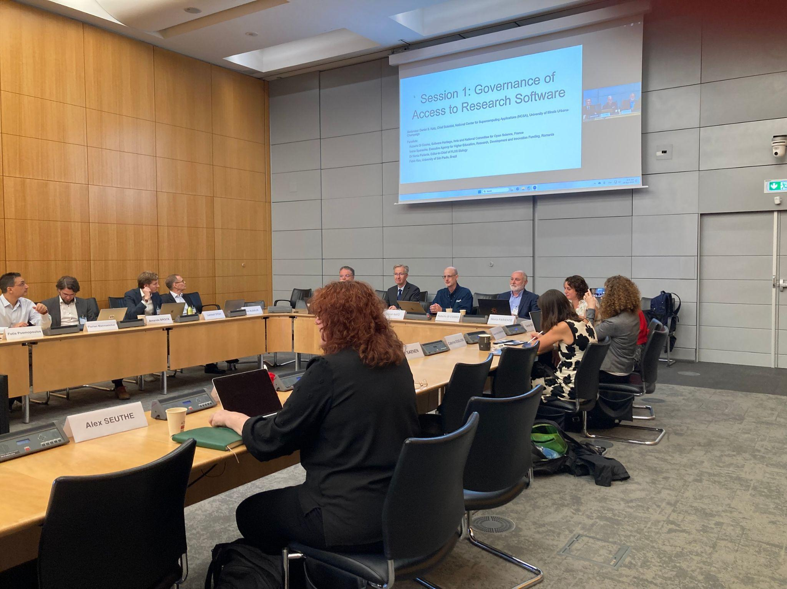
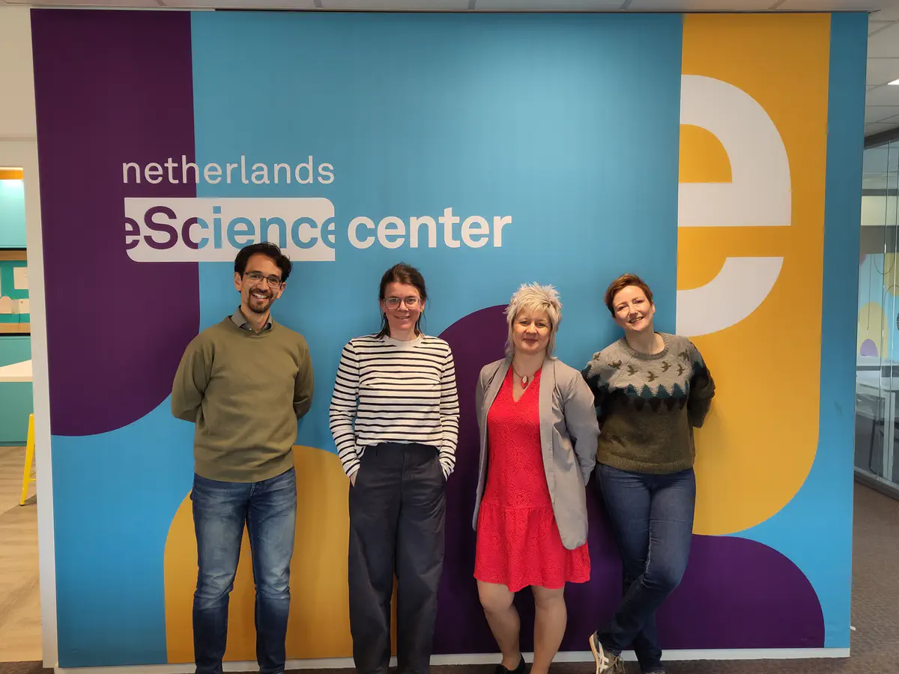
Advancing research software policy
OECD workshop on Policies for research software in the age of artificial intelligence. ReSA's Research Software Policy Forum is continuing aligned discussions.
Amsterdam Declaration on Funding Research Software Sustainability (ADORE.software) - Dutch signatories recently shared implementation experiences and identified next steps in this blog post.
Image credit: Netherlands eScience Center

Slide 20

Research software citation & publishing
CHORUS & ReSA webinar Embedding Research Software into Scholarly Publishing discussed progress in improving software citation, reproducibility, and recognition.
Research Software Infrastructure (RSI) Forum WG on Making Software Citation Easy and Useful addressed metadata, credit attribution, and machine actionable software citation in this blog post.
Two new Publishing Research Software (PubSoft) Forum WGs on peer review of code in publications and separating data and code in open-science policies.

Slide 21

Partnerships & global engagement
ReSA has become an institutional partner in the new Open Source for Science Fund, a multi-donor philanthropic initiative led by Renaissance Philanthropy with support from Biohub, Wellcome, and Kavli.
ReSA’s collaboration with the Research Data Alliance (RDA) and Red Latinoamericana y de España de Ciencia Abierta (LA Referencia) on research software, research data and open science in Latin America and the Caribbean engaged more than 1,100 participants through six multilingual webinars (see blog post).
Image credit: Unsplash

Slide 22
Policies for research institutions
The work of the PRO4RS WG identified the following recommendations for research organisations wishing to better support research software in their institutional policies:
We recommend incorporating support for research software and those who develop and maintain it into existing policies and/or creation of a single policy on research software.
We recommend updating institutional policies to explicitly address research software in a range of categories (see report for list).
We recommend considering engaging a wide range of parts of the research organisation to support the process to create organisational policies that support research software and its personnel. A bottom-up and/or top-down approach may be suitable depending on each organisation’s context.
We recommend appropriate skills and training, community building, digital infrastructure and incentives and rewards that enable incorporation of research software recognition and support into institutional policies.

Slide 23
Starting an RSE group - Resources
1. Anatomy of a Central RSE Team, 2023.
2. How to start an RSE Group by Society of RSE, 2019. (14 case studies)
3. The Princeton University Research Software Engineering Group Model
4. RSE-leaders/evidence-bank from the RSE Group Evidence Bank. (Case studies)
5. Research Software Development & Management in Universities: Case Studies from Manchester's RSDS Group, Illinois' NCSA, and Notre Dame's CRC, 2019.
6. RSE Starter Pack. Includes definitions for RSEs, community website template, etc.
7. RSEs in Research? RSEs in IT?: Finding a suitable home for RSEs, 2020.

Slide 24



7-8 September 2026
Sheffield, UK & online
Co-located with RSECon26
www.researchsoft.org/irsc/
Our purpose:
Participants:
Learn more:
To advance global shifts toward strategic coordination, long-term sustainability, and high-level collaboration across the research software community.
Leaders and change-makers:
RSEs, funders, policy makers, publishers, infrastructure organisations, skills & training initiatives, national/regional RSE associations, etc.
Register to attend
Join the IRSC mailing list for updates
Connect on ReSA’s Slack: #irsc

Slide 25
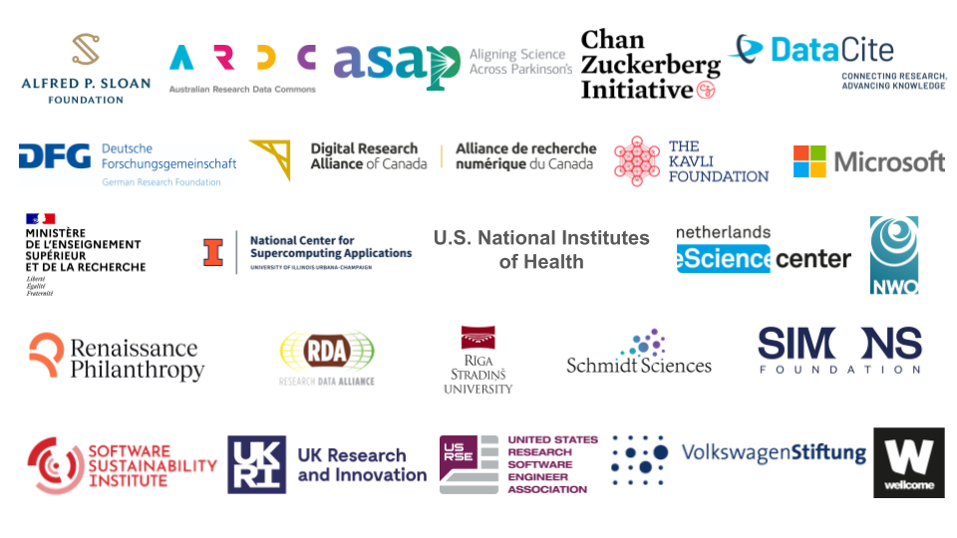
Our Partners

Slide 26
To learn more
About ReSA:
Receive updates through our regular newsletter
Join the ReSA Slack to share what’s happening in the community
Question for the audience: Do we still need to make the argument for the value of RSEs?

Slide 27
References
…
[7] A. Ha, “Ford rehires ‘gray beard’ engineers after AI falls short,” TechCrunch. Accessed: Jul. 23, 2026. [Online]. Available: URL
[8] R. Bellan, “The token bill comes due: Inside the industry scramble to manage AI’s runaway costs,” TechCrunch. Accessed: Jul. 23, 2026. [Online]. Available: URL
[9] D. Keller, “Why Companies Regret Laying Off Workers For AI,” Forbes. Accessed: Aug. 16, 2026. [Online]. Available: URL
[10] S. Perez, “Meta’s Adam Mosseri says AI token budgets could soon be capped per engineer,” TechCrunch. Accessed: Jul. 23, 2026. [Online]. Available: URL
[11] S. Bonabi, S. Bana, V. Gurbaxani, and T. Nian, “Beyond Code: The Multidimensional Impacts of Large Language Models in Software Development,” arXiv.org, 2025, doi:10.48550/arxiv.2506.22704.
[12] S. Peng, E. Kalliamvakou, P. Cihon, and M. Demirer, “The Impact of AI on Developer Productivity: Evidence from GitHub Copilot,” arXiv.org, 2023, doi:10.48550/arXiv.2302.06590.
[13] K. Z. Cui, M. Demirer, S. Jaffe, L. Musolff, S. Peng, and T. Salz, “The Effects of Generative AI on High-Skilled Work: Evidence from Three Field Experiments with Software Developers,” Management Science, Feb. 2026, doi:10.1287/mnsc.2025.00535.
[14] C. Qian and J. Wexler, “Take It, Leave It, or Fix It: Measuring Productivity and Trust in Human-AI Collaboration,” in Proceedings of the 29th International Conference on Intelligent User Interfaces, ACM, Mar. 2024, pp. 370–384. doi:10.1145/3640543.3645198.
[15] A. Mohamed, M. Assi, and M. Guizani, “The Impact of LLM-Assistants on Software Developer Productivity: a Systematic Review and Mapping Study,” ACM Transactions on Software Engineering and Methodology, 2025, doi:10.1145/3809494.
[16] T. Weber, M. Brandmaier, A. Schmidt, and S. Mayer, “Significant Productivity Gains through Programming with Large Language Models,” Proceedings of the ACM on Human-Computer Interaction, vol. 8, pp. 1–29, Jun. 2024, doi:10.1145/3661145.
[17] H. He, C. Miller, S. Agarwal, C. Kästner, and B. Vasilescu, “Speed at the Cost of Quality: How Cursor AI Increases Short-Term Velocity and Long-Term Complexity in Open-Source Projects,” arXiv.org, 2025, doi:10.48550/arXiv.2511.04427.
[18] H. He, C. Miller, S. Agarwal, C. Kästner, and B. Vasilescu, “Speed at the Cost of Quality,” in Proceedings of the 23rd International Conference on Mining Software Repositories, ACM, Apr. 2026, pp. 181–193. doi:10.1145/3793302.3793349.
[19] S. Druskat, M. Felderer, and C. Haupt, “Software engineering, research software and requirements engineering,” Softwaretechnik-Trends, vol. 44, no. 1, pp. 12–15, 2024.
[20] S. Druskat et al., “Evolution of the Research Software Engineer role in the age of generative and agentic AI,” May 2026, doi:10.5281/zenodo.20050753.

